Slide 1


Health Care Data Analytics
--- A WAY TO ACHIVE “HEALTH FOR ALL”
Project by : Suraj kumar , Shivlal Prasad Azad ,
Raju kumar
Guide by : [Arpita Roy]
[ Sayanti manna ]

Slide 2
Table of Contents
S.no | Title
1 | Project Overview
2 | Problem Statement
3 | Why we need This ?
4 | How will help people?
5 | How it’s unique
7 | Our Solution’s
8 | Modelling (Analysis Model) And Visualization
9 | Live Demo – Analysis Dashboard
10 | Result(Prediction Model)

Slide 3
1
Data Capturing , Gathering
We used Kaggle.com website to find data set and tried to analyze that , downloaded the csv file from Kaggle.com .
Pre – Process
Filter the data here according to our need check null values if there is any replace them , remove all unnecessary things which will not wanted in our analysis part.
EDA
Exploratory Data Analysis it is a approach is use to analyze and visualize the data using different methods and techniques used matplotlib in visualization part
Model
created Train and test sets and then converted into x_train and y_train and then created and fit the LSTM network which will used for prediction of our data set.
2
Project Overview
Our goals is to create a platform that would evaluate and predict the healthcare related issue, so we started the with Jupiter notebook and gathered data, filtered it, then moved on to visualisation, and eventually created a prediction model for this data set.
3
4

Slide 4

Problem Statement
Identify potential risks that may affect the project's success and outline a risk mitigation plan.
Chronic diseases, such as diabetes, heart disease, and hypertension, affect a significant portion of the population. Managing these conditions involves complex treatment plans, lifestyle adjustments.
The population or patient group that is affected by this problem. Highlight the specific challenges or issues related to the problem.

Slide 5

Why we need this ?
Improved Patient Care: Healthcare data analytics can lead to better patient outcomes. By analyzing patient data. Predictive analytics can help identify high-risk patients.
Chronic Disease Management: Many patients suffer from chronic diseases that require ongoing management. Data analytics can assist in monitoring these patients, ensuring they receive the right care at the right time to keep their conditions under control.
Public Health Monitoring: Data analytics can be used to track the spread of diseases and monitor public health trends.

Slide 6

How it will help people?
It’s not easy to predict the health of people now day.
We have to analyze the previous performances of that health record in hospital. So we need a platform which can help in analyzing the data of health and can predict the health care .
Our healthcare data analytics project is poised to make a profound difference in the lives of individuals.

Slide 7
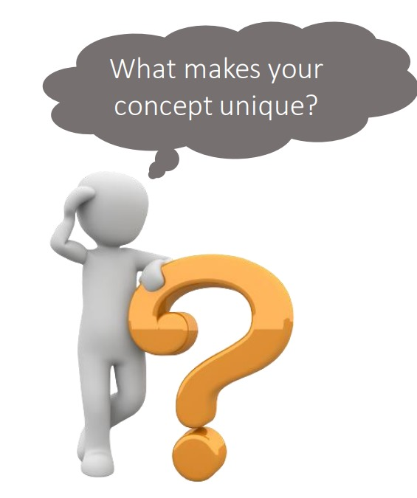
What makes our concept unique?
Our healthcare data analytics project is not just another initiative—it stands out distinctly in its approach and potential impact.
Our uniqueness lies in a proactive healthcare model; it's about anticipating and preventing health issues through predictive analytics rather than merely reacting.
Our project becomes a catalyst for positive change in the lives of individuals and communities.

Slide 8

Our Solution To Analyze and Predict The Health Care Condition
IDEA
We created a Platform using jupyter notebook to assist individuals in analyzing Their Health care
Gather Data And Filter it
First took a dataset to work from coin-desk and start filtering it using pandas , to do further processing on it.
Analyze and visualization
Start analyzing the filtered data is there any null values or not, and then start ploting the required data into graphs using matplotlib.
Train Model for prediction
Trained model using sklearn and keras libraries , Created the LSTM network and then plot the final prediction using matplotlib

Slide 9
Live demo- analysis

Slide 10
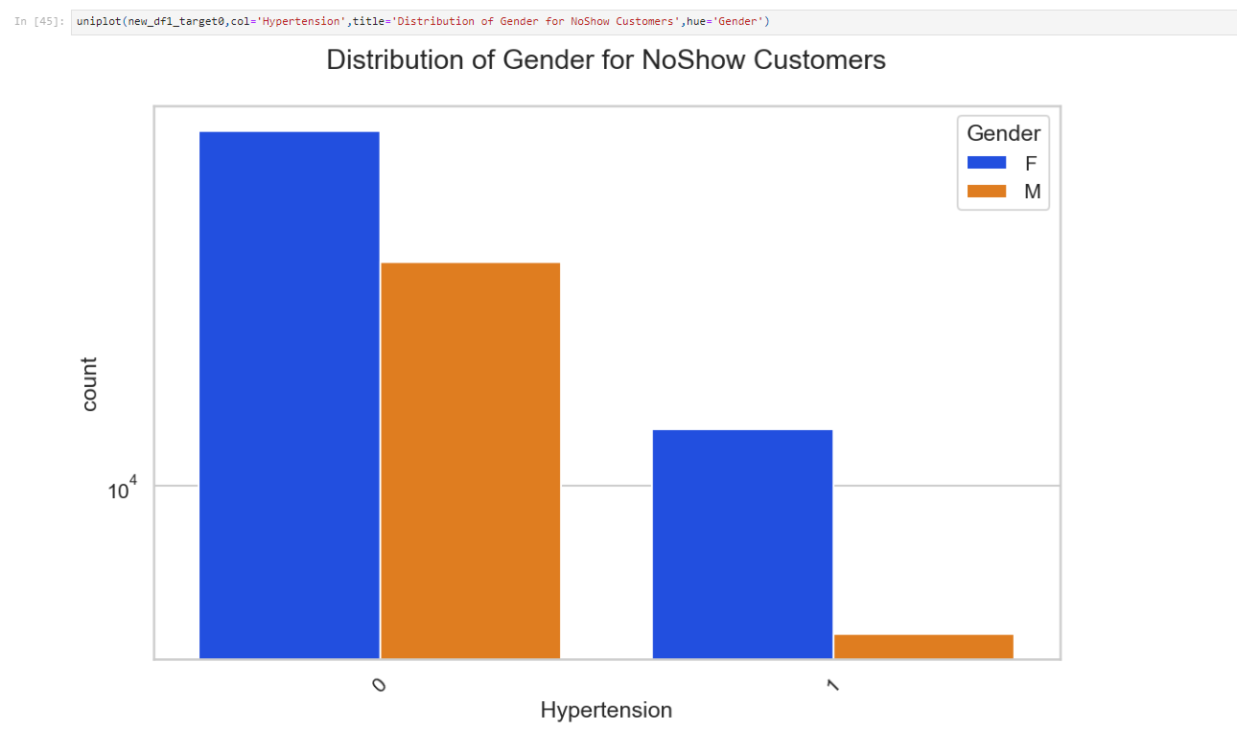
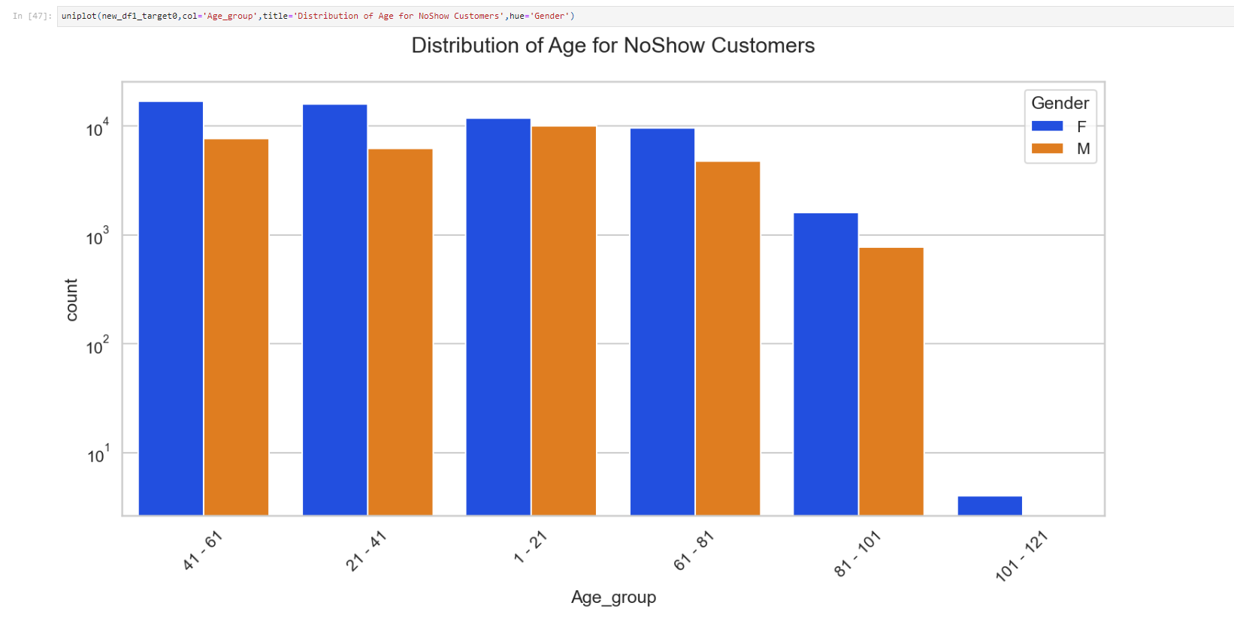
Modelling (Analysis Model) And Visualization
uniplot(new_df1_target0,col=‘ Age_ group’, title=
'Distribution of Age for NoShow Customers',hue='Gender')
Uniplot(new_df1_target0,col='Hypertension’,
title='Distribution of Gender for NoShow Customers’, hue='Gender')

Slide 11
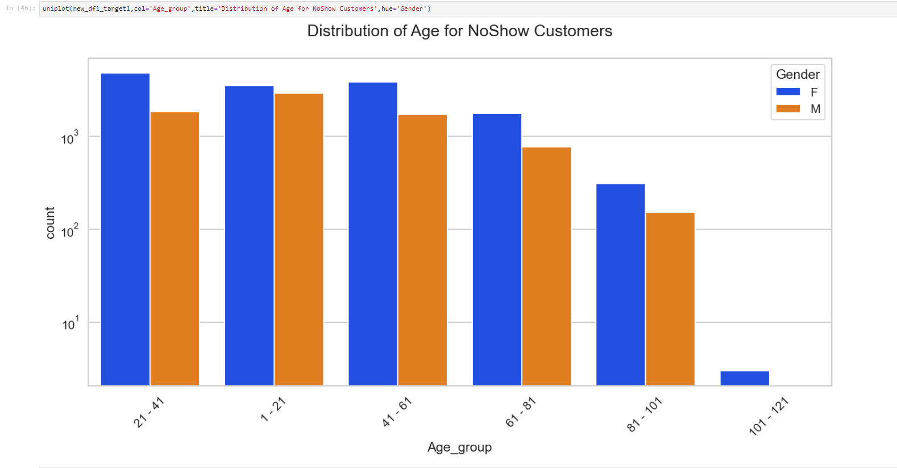
OUTCOME(Prediction Model)
1. Created train and test sets.
2. converted dataset into Count and Age_group. .
3. Got these predicted Age_ Group
4. Plotted the predicted Distribution of Age for Noshow Customer in graph.
5. Orange line shows the predicted Male & Blue line shows the predicted Female.

Slide 12

Thank You
Credit Goes To :
Ms . Arpita Roy
Sayanti manna
IBM
Google

